Slide 1

8th Grade Math: Pre-Algebra
Unit 12, Lesson 3 Multiplying Algebraic Expressions Volume 2, pg. 226

Slide 2


Benchmarks
MA.8.AR.1.1
Apply the Laws of Exponents to generate equivalent algebraic expressions, limited to integer exponents and monomial bases.
MA.8.AR.1.2
Apply properties of operations to multiply two linear expressions with rational coefficients.
volume 2, pg. 226

Slide 3
Integrated Mathematical Thinking and Reasoning Standards
MA.K12.MTR.1.1 Actively participate in effortful learning both individually and collectively.
MA.K12.MTR.2.1 Demonstrate understanding by representing problems in multiple ways.
MA.K12.MTR.3.1 Complete tasks with mathematical fluency.
MA.K12.MTR.4.1 Engage in discussions that reflect on the mathematical thinking of self and others.
volume 2, pg. 226

Slide 4

Learning Target
I can apply properties of operations to multiply two algebraic expressions.
volume 2, pg. 226

Slide 5

Warm-Up
volume 2, pg. 227

Slide 6
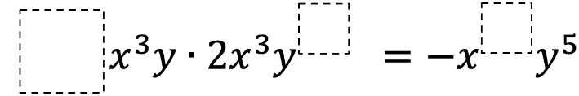
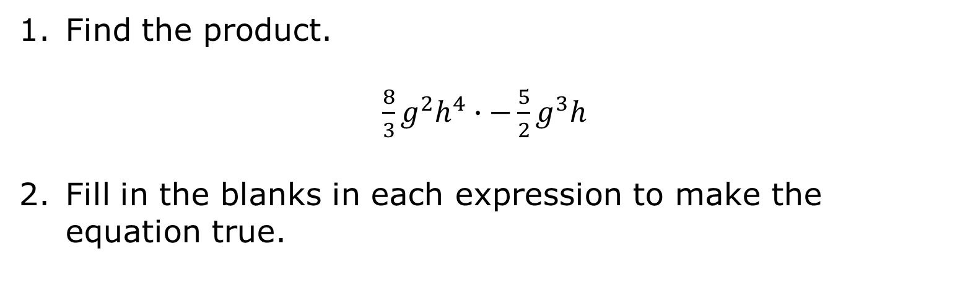
12.3.1 Warm-Up: Bell Work
Find the product.
${\frac{8}{3}g}^{2}h^{4}∙{−\frac{5}{2}g}^{3}h$
Fill in the blanks in each expression to make the equation true.
volume 2, pg. 227

Slide 7

Guided Practice
volume 2, pg. 227

Slide 8

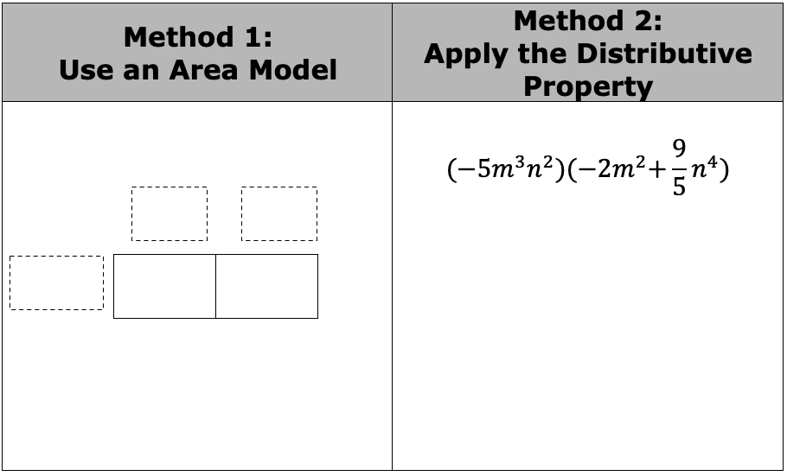
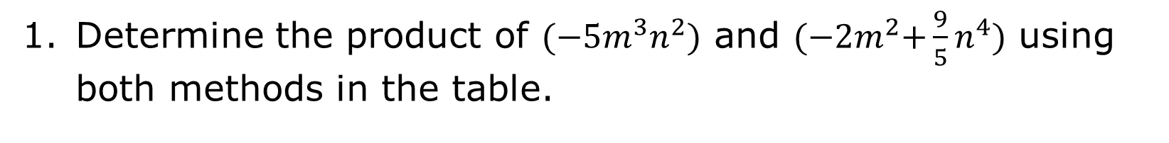
12.3.2 Guided Practice: Multiplying Monomials by Algebraic Expressions
Determine the product of ${(−5m}^{3}n^{2})$ and $(−{2m}^{2}{+\frac{9}{5}n}^{4})$ using both methods in the table.
volume 2, pg. 227

Slide 9
Work with your partner to find three expressions equivalent to $3x^{2}(−2x^{3}+x)$.
volume 2, pg. 227

Slide 10

Collaboration
volume 2, pg. 228

Slide 11

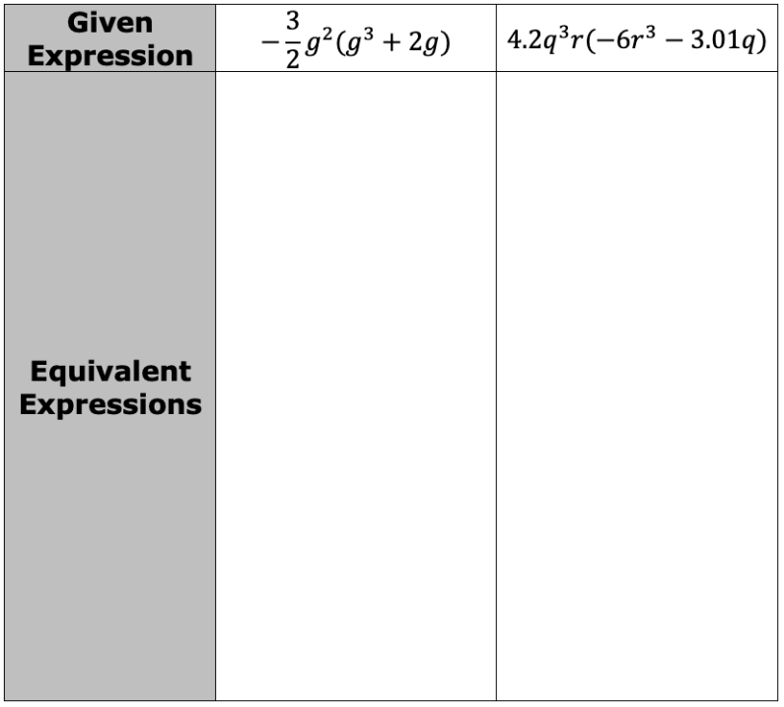
12.3.3 Collaboration: Equivalent Expressions
Two expressions are shown in the table. For each expression, work with your partner to find as many equivalent expressions as you can.
volume 2, pg. 228

Slide 12
Find another partner pair and compare your expressions from the previous question. Discuss any differences and add any additional equivalent expressions to your table.
volume 2, pg. 228

Slide 13

Activity
volume 2, pg. 228

Slide 14

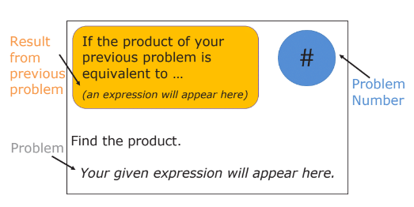
12.3.4 Activity: Scavenger Hunt
Work with your partner or group to complete the scavenger hunt. Each card in the scavenger hunt appears as shown.
volume 2, pg. 228

Slide 15
Write the number of the problem you start with and the given expression in the first row of the table. Then, work with your group or partner to find the product of the given expression.
Look for the card with your product from the previous problem to find your next problem.
Repeat this process until your group has completed all the scavenger hunt problems and have ended up back at your original problem.
volume 2, pg. 228

Slide 16
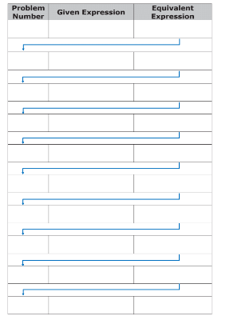
volume 2, pg. 229

Slide 17

Wrap-Up
volume 2, pg. 229

Slide 18
12.3.5 Wrap-Up: Reflection
Draw an X on the line to indicate how you feel about today’s learning target.
I can apply properties of operations to multiply two algebraic expressions.
I need help.
I can’t multiply two algebraic expressions.
I’m getting there.
I understand and have evidence.
Explain your placement of “X” on the scale.
volume 2, pg. 229

